Slide 1


AIR QUALITY INDEX AUTOMATION, STATISTICAL ANALYSIS & FORECASTING
By: Guide:
Palak Goel (21MDT0041) Dr. Jitendra Kumar (15975)
MSc. Data Science
School of Advanced Sciences
Vellore Institute of Technology, Vellore
1

Slide 2

Problem Statement
India is the fifth-most polluted country in the world, and the rapid rise in pollution is having a significant impact on the environment in a number of important cities.
This study will measure air pollution trends and
also evaluate the air quality index with respect
to various geographic locations in order to get
a global perspective of the harm caused by
air pollution and to design suitable methods to
prevent it in the future.
The air quality index is one tool for assessing the
current state of air quality. Six different methods
of calculating the Air quality Index (AQI) based on
the synergistic impacts of the four pollutants PM10,
PM2.5, SO2, and NO2 will be used to compare the existing ambient air quality in
the research area.
21MDT0041 Palak Goel Master Thesis
2

Slide 3
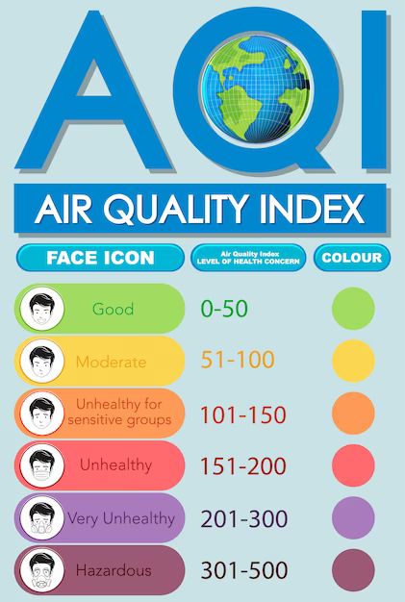
Abstract
In this regard, the Central Pollution Control Board and the Ministry of Environment, Forestry, and Climate Change's data were used to create the polluted database (India). These statistics, which were gathered at several monitoring stations in the cities of India, show the annual growth of SO2, NOx, and particulate matter (PM) 2.5 in 2021.
The findings indicate that multiple transport modes, small- and large-scale power generation (from diesel, coal, and gas plants), industries, constructions, and residential cooking were the sources of SO2, NOx, and PM 2.5.
Overall, India had a trend that was becoming worse every day. According to the findings, that used as a trained dataset for Machine learning algorithms the locations under consideration fell into four categories: critically contaminated (CP), highly polluted (HP), moderately polluted (MP), and low polluted. Using satTScan for finding the cluster or hotspot of pollution.
21MDT0041 Palak Goel Master Thesis
4

Slide 4

Objective
AQI Automation.
Studying which particulate matter(PM10, PM2.5, SO2, and NO2) effecting the air quality for respective states.
Identifying most polluted state and air particulate
prevailing in that region.
Visualization over India map.
Simulation for real time analysis
Hotspot detection.
Predicting air quality on the basis of PM10, PM2.5, SO2, and NO2 values.
21MDT0041 Palak Goel Master Thesis
5

Slide 5
Work Plan
Extracting the data from government website (i.e. https://cpcb.nic.in/)
Converting the data into csv format
Calculating the sub-indexes of different pollutants
Statistical analysis of pollutants using Anova
Automating the AQI Evaluation using python
Categorising AQI as good, moderate , hazardous…
Training the model using different Machine learning algorithms
Predicting the air quality using trained model
Hotspot Analysis using SaTScan.
21MDT0041 Palak Goel Master Thesis
11

Slide 6
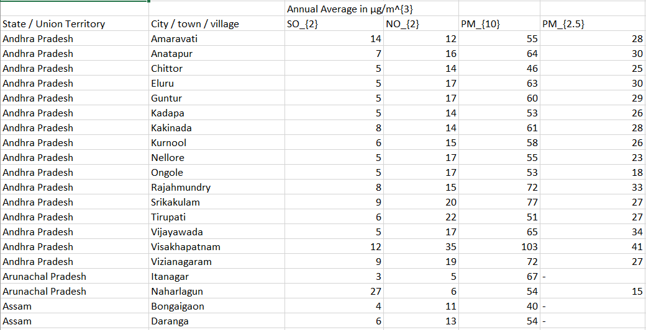

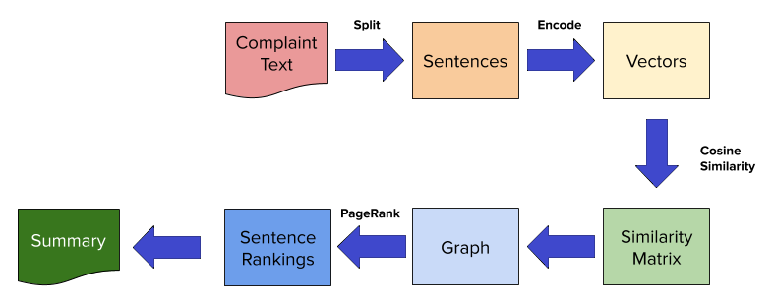

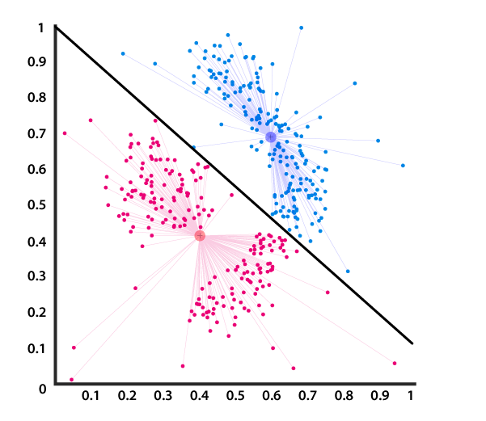
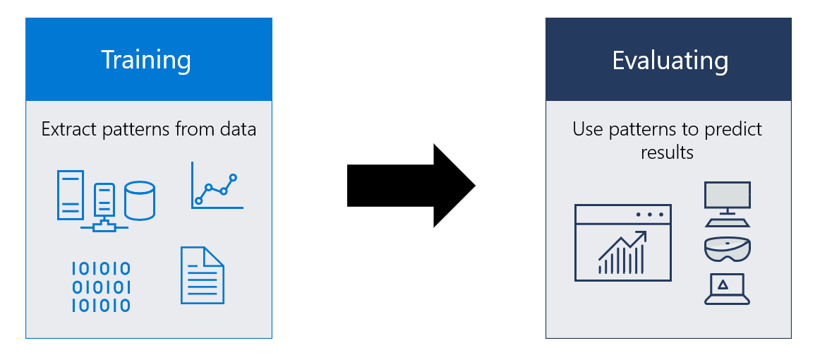
Work Plan
21MDT0041 Palak Goel Master Thesis
12

Slide 7
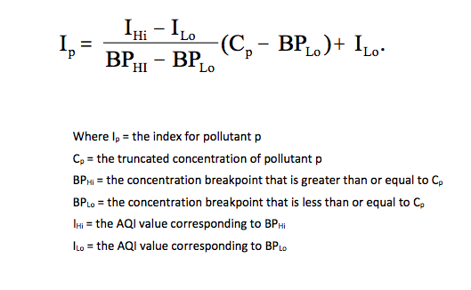
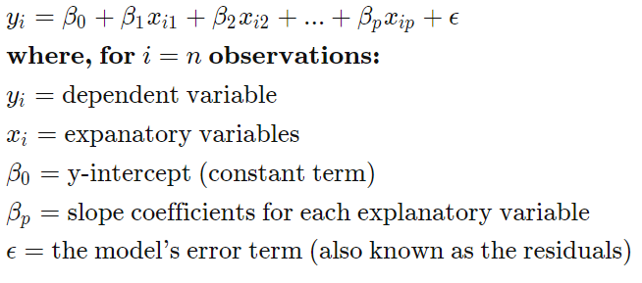
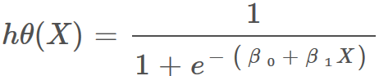
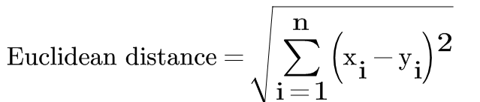
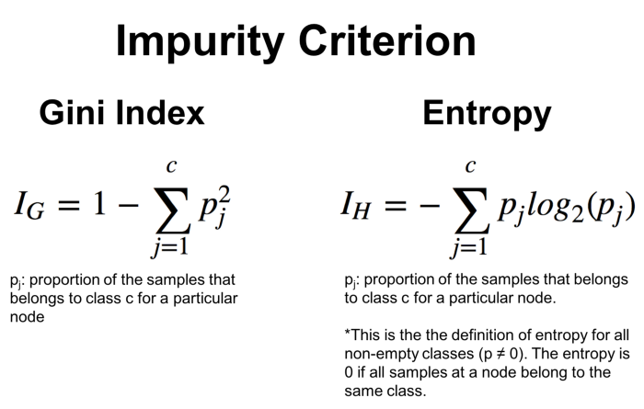
Methodology
AQI Formulation:
Machine Learning Algorithm:
Multiple Linear Regression:
Logistic Regression:
K Nearest Neighbour:
Decision Tree:
Simulation
SaTScan for clustering and hotspot analysis
21MDT0041 Palak Goel Master Thesis
13

Slide 8

Methodology
Under statistical analysis
One way Anova to study the contribution of air
particulate matter in AQI level,
Correlation Analysis for the judgement of
multicollinearity
Treating missing values by using imputation or
ffill, bfill.
21MDT0041 Palak Goel Master Thesis
14

Slide 9
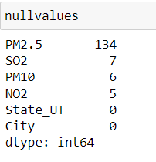
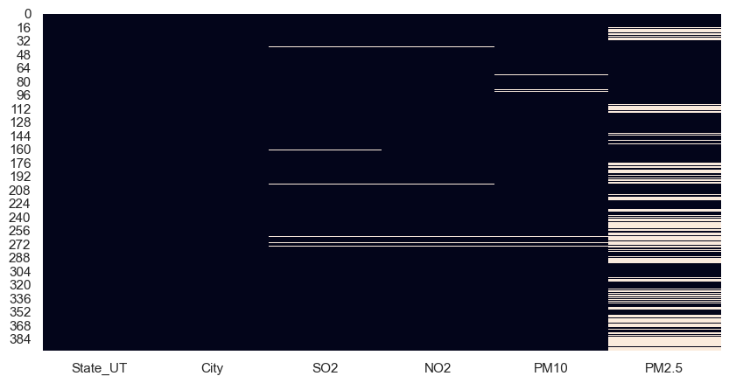
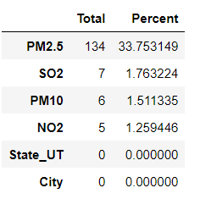
Results
21MDT0041 Palak Goel Master Thesis
5

Slide 10
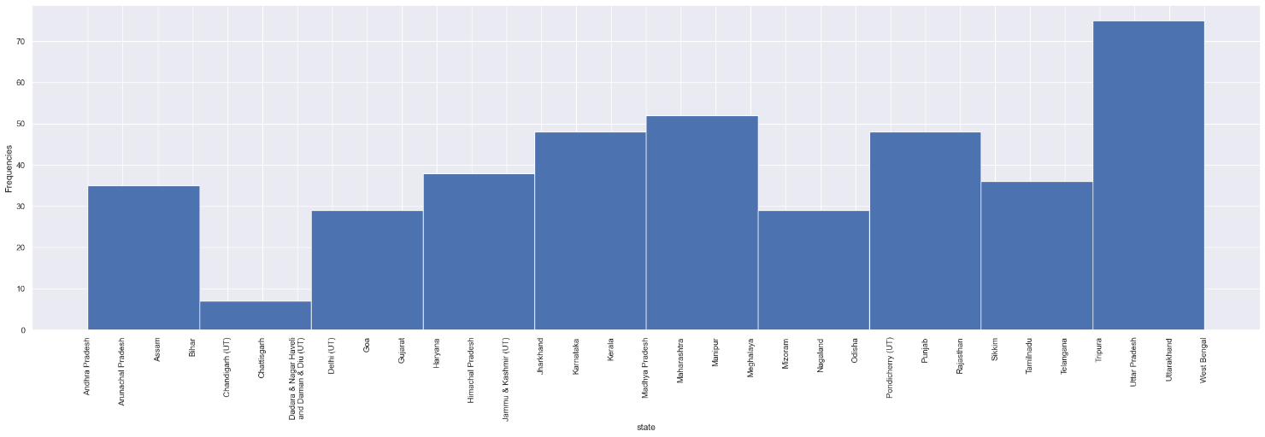
Count of States present in the dataset

Slide 11
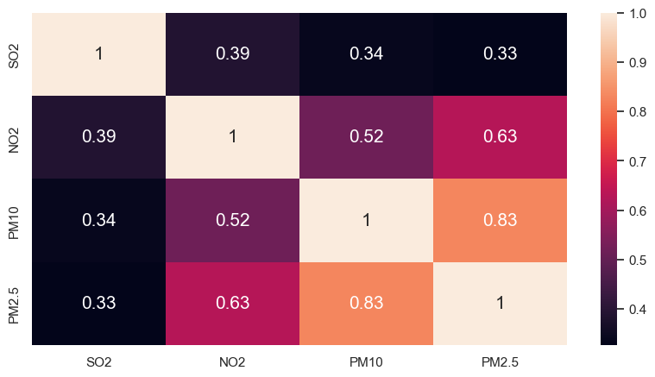
Correlation Heat Map(with in predictors)
This shows that PM10 and PM2.5 are Correlated as their Correclation Value is greater than 0.5

Slide 12
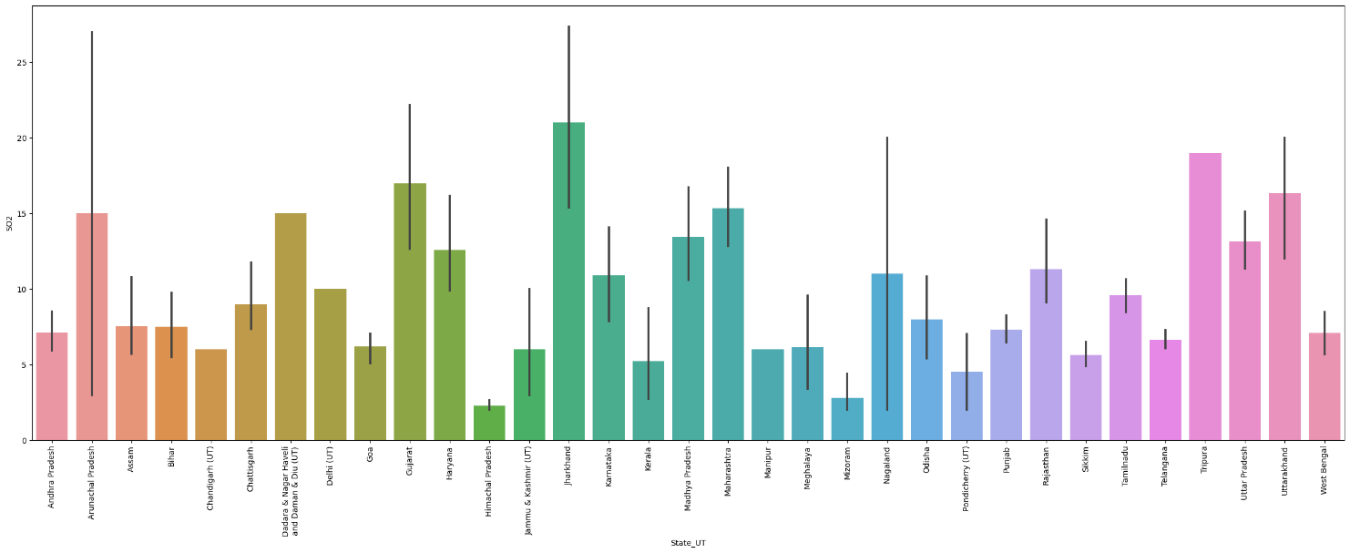
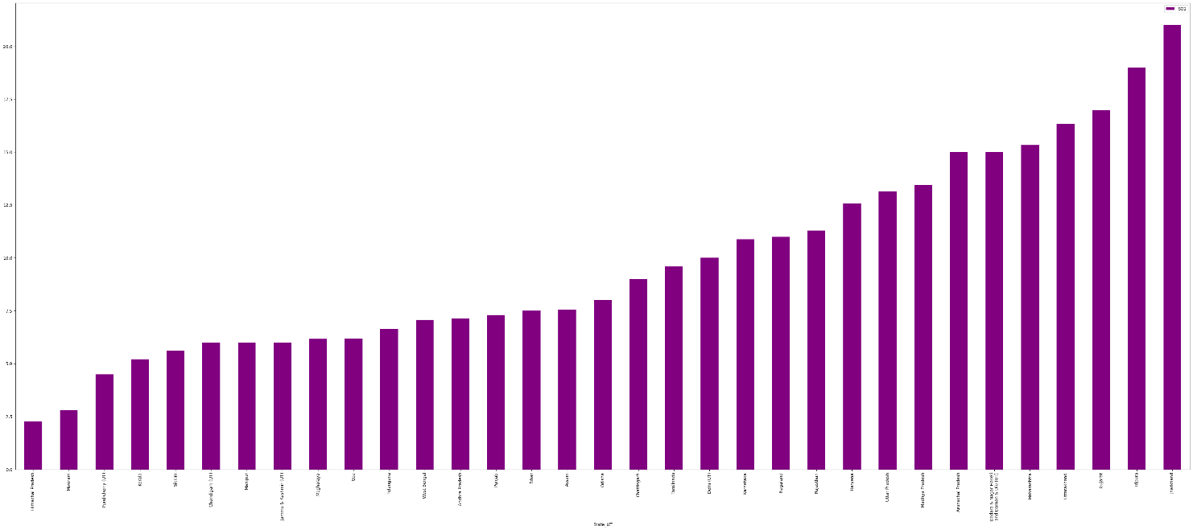
This visualization shows the name of the state having higher SO2 levels in the air which is Jharkhand followed by Tripura

Slide 13
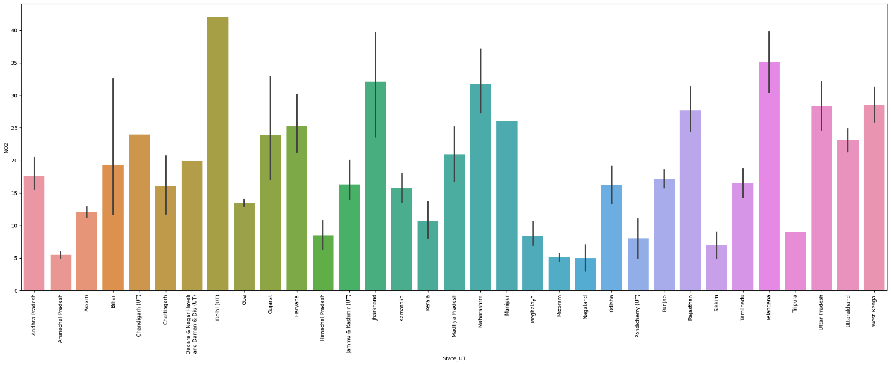
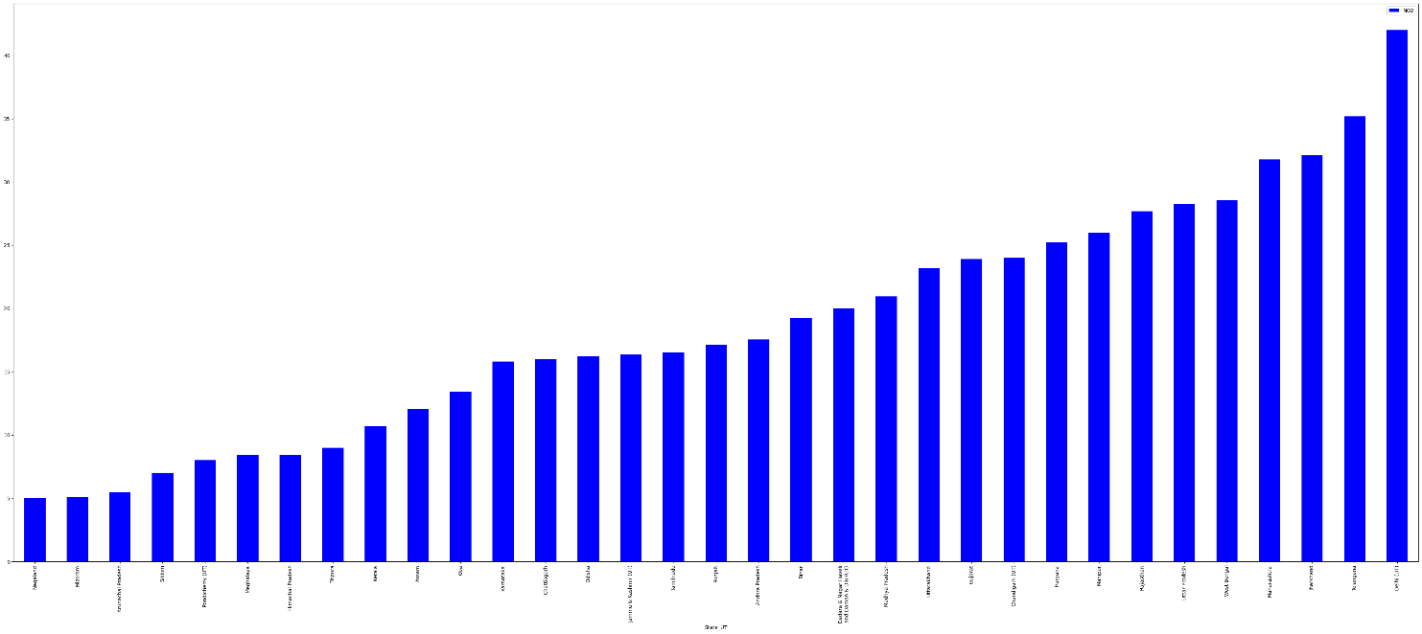
This visualization shows the name of the state having higher NO2 levels in the air which is Delhi followed by Telangana

Slide 14
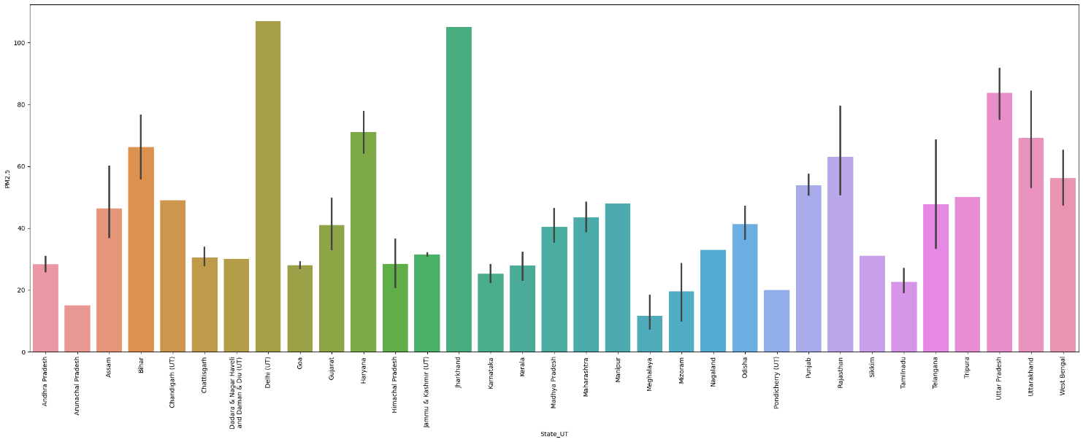
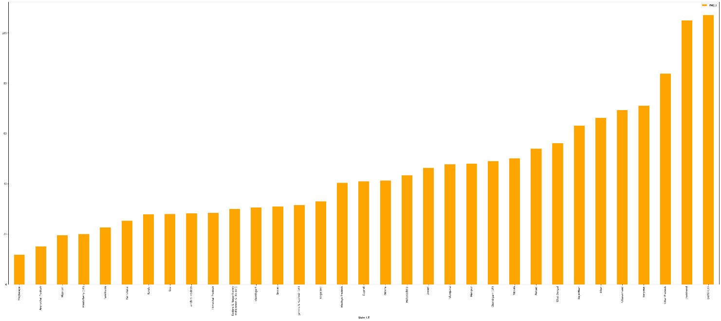
This visualization shows the name of the state having higher PM2.5 levels in the air which is Delhi followed by Jharkhand

Slide 15
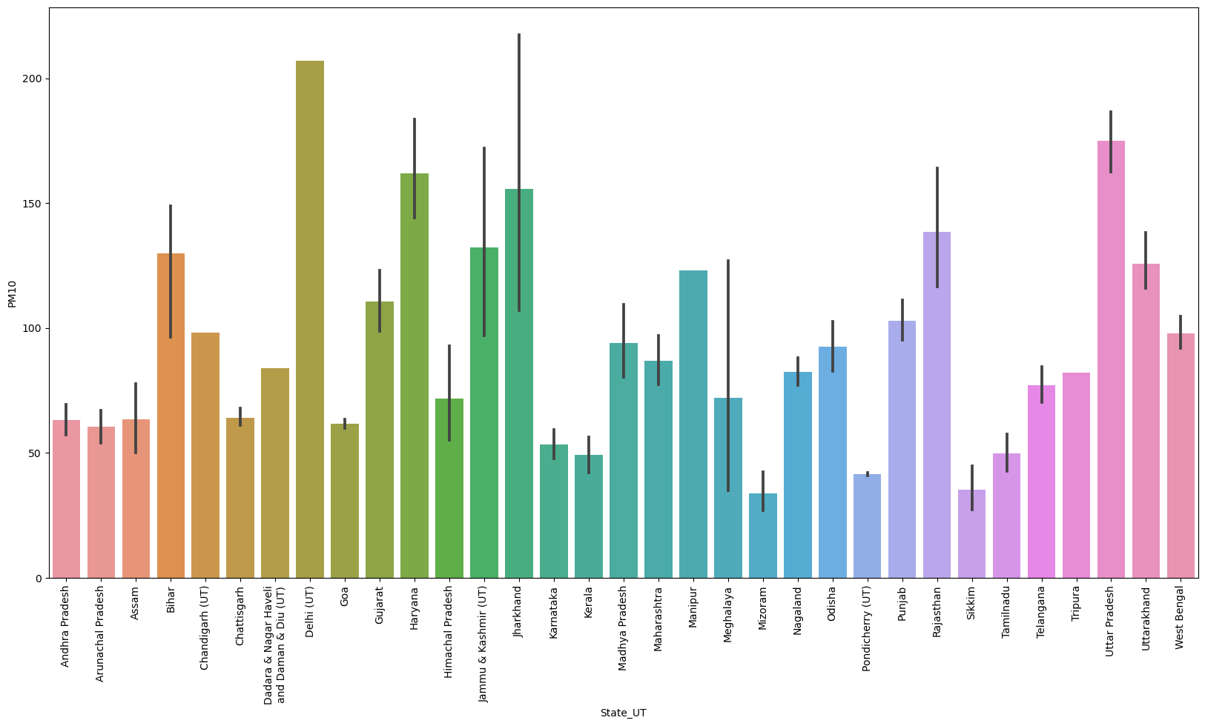
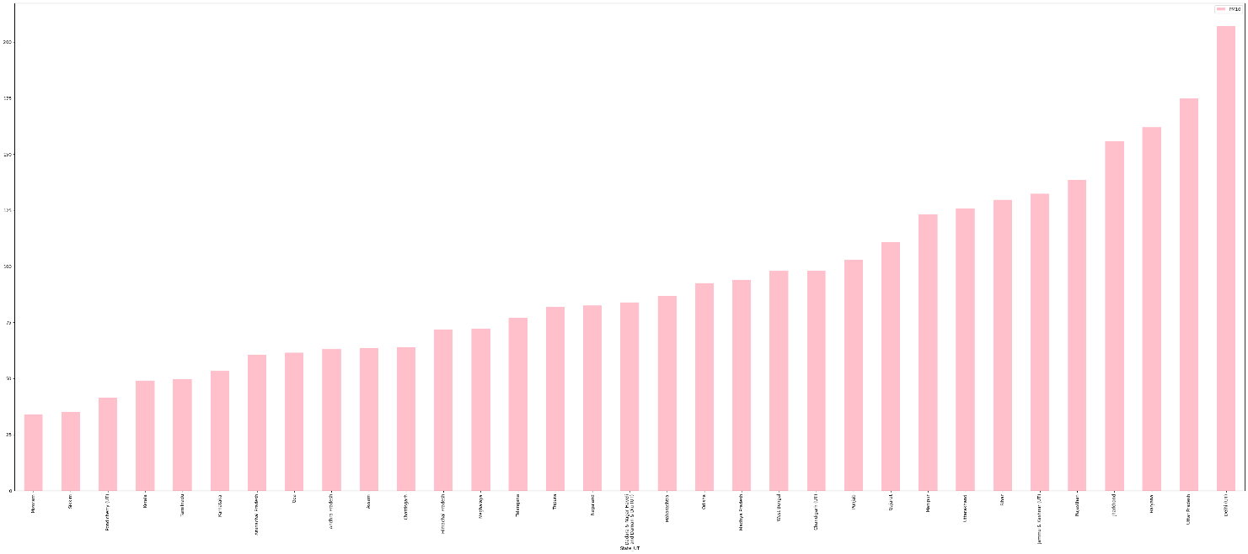
This visualization shows the name of the state having higher PM10 levels in the air which is Delhi followed by Uttar Pradesh

Slide 16
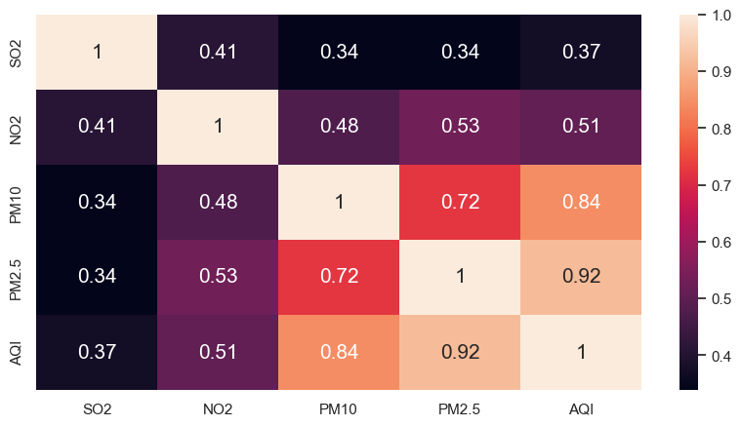
Correlation Heat Map between dependent variable i.e AQI and independent variable
This Shows that PM2.5 and PM10 has greater correlation and it indicates the presence of multicollinearity in our dataset as it will lead to dependency among explanatory variables

Slide 17
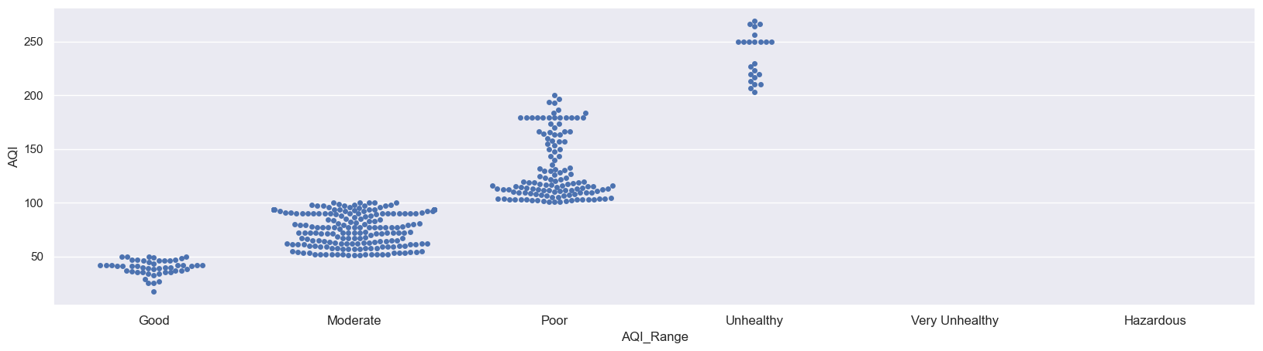
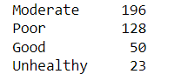
Swarm Plot of AQI Range

Slide 18
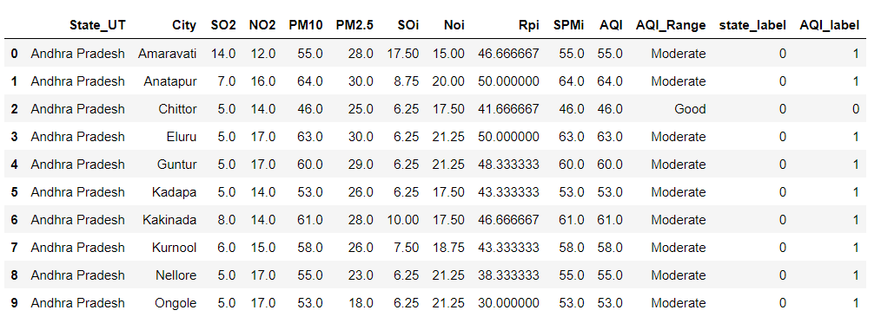
DATASET after data preprocessing for model training

Slide 19
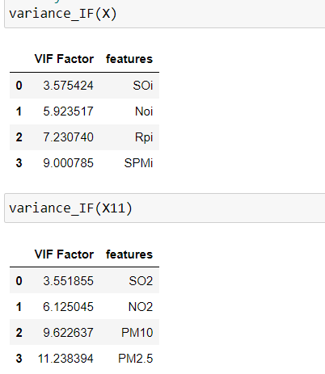
Table 7.4 VIF for checking multicollinearity

Slide 20
Results for Regression algorithm
REGRESSION ALGORITHM | R2 Score(for PM10,PM2.5, SO2, NO2) For train data | R2 Score(PM10, SO2, NO2) For train data
Linear Regression | 0.94 | 0.68
Support Vector Machine | 0.68 | 0.51
Decision Tree | 1 | 0.99
Random Forest | 0.99 | 0.96
REGRESSION ALGORITHM | R2 Score(for PM10,PM2.5, SO2, NO2)for test data | R2 Score(PM10, SO2, NO2) For test data
Linear Regression | 0.95 | 0.81
Support Vector Machine | 0.77 | 0.74
Decision Tree | 0.99 | 0.58
Random Forest | 0.99 | 0.77

Slide 21
Results for classification algorithm
Classification Algorithm | Accuracy Score(for PM10,PM2.5, SO2, NO2)for test data | Accuracy Score (for PM10, SO2, NO2) for test data
Logistic Reression | 0.73 | 0.77
K Nearest Neighbour | 0.91 | 0.90
Classification Algorithm | Accuracy Score(for PM10,PM2.5, SO2, NO2) FOR train data | Accuracy Score (for PM10, SO2, NO2) for train data
Logistic Reression | 0.77 | 0.81
K Nearest Neighbour | 0.95 | 0.89

Slide 22
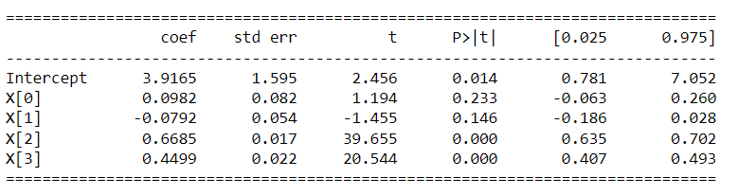
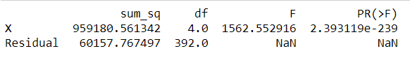
Anova analysis
ANOVA | For SO2, NO2, PM2.5, PM10 | For SO2, NO2, PM10 | For SO2, NO2
R-Square Value | 0.94 | 0.70 | 0.29
The larger the F value, the more likely it is that the variation associated with the AQI is real and not due to chance.
The p value for the F statistic is shown in the Pr(>F) column. This demonstrates how likely it is that the F value would have happened if the null hypothesis that there is no difference between the group means were true.Because the p value of the independent variables, X consist of particulate matter , is statistically significant (p < 0.05), it is likely that particulate matter type does have a significant effect on AQI.
After removing the independent variable I observed that R-Square value for the model decreased which indicates that prediction for that model will be less precised so we are taking SO2, NO2, PM2.5, PM10 as our independent variables.

Slide 23
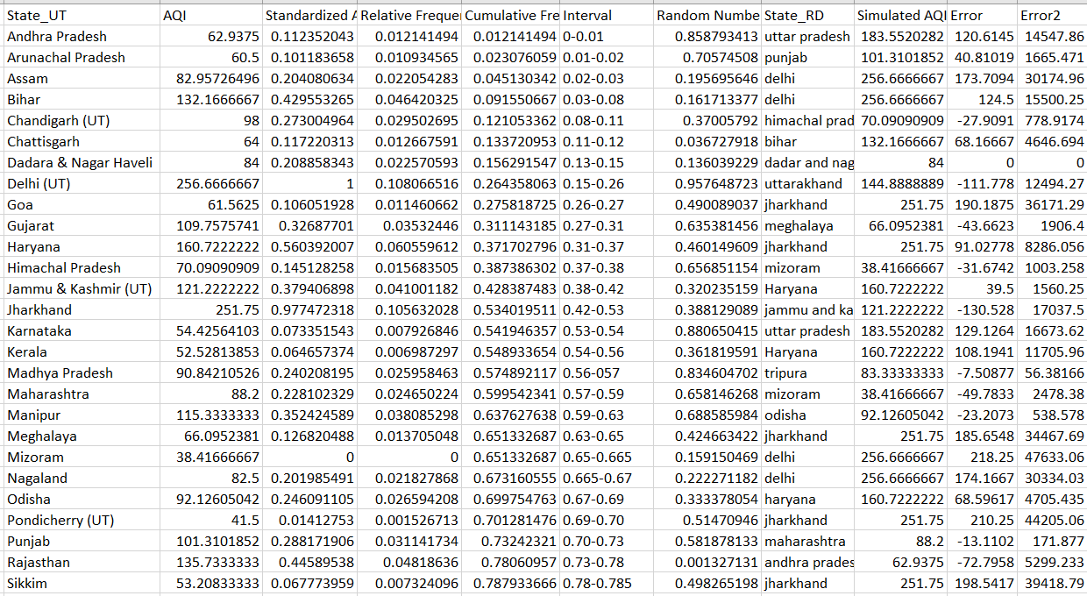
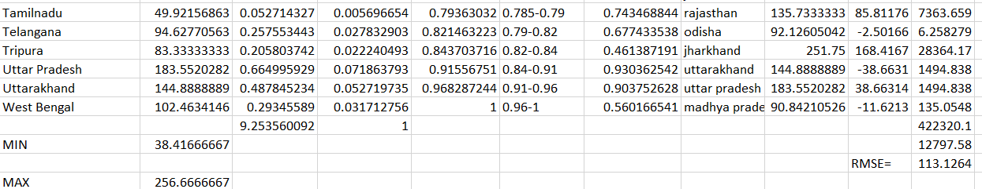

Slide 24
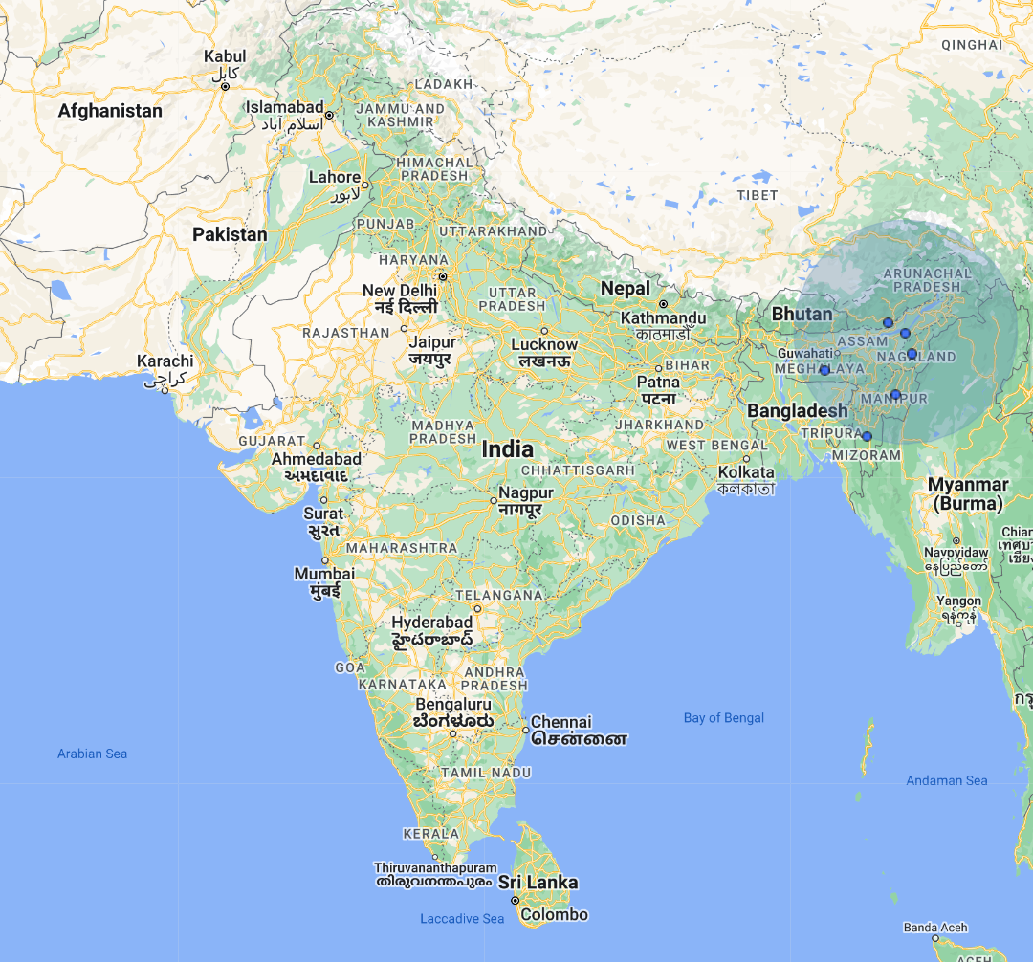
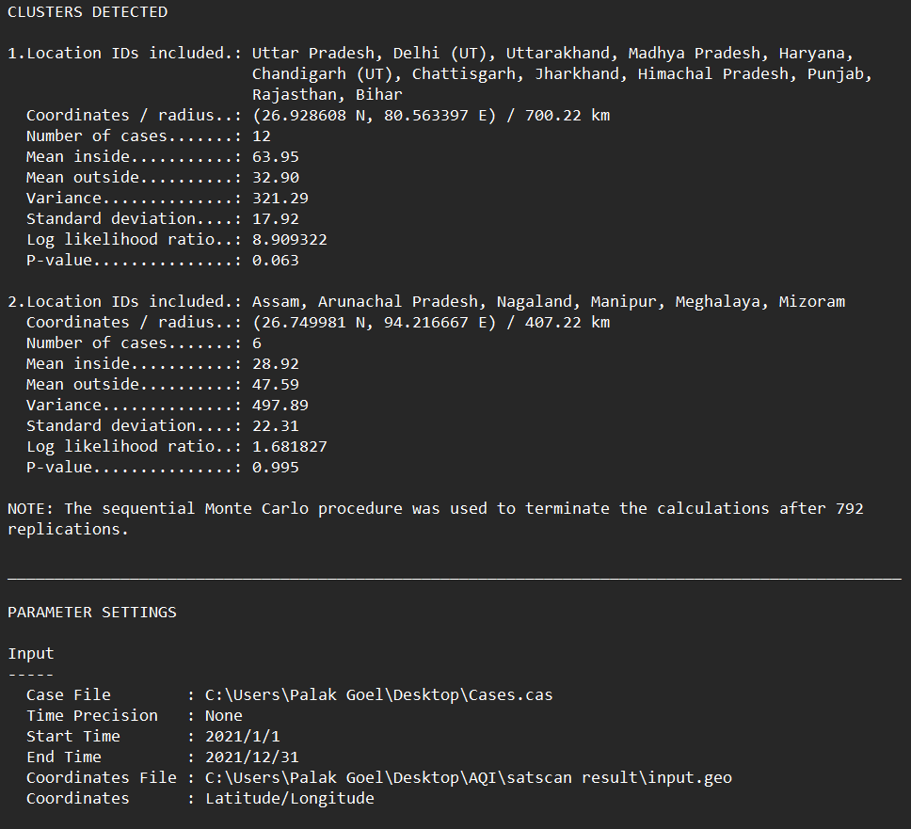
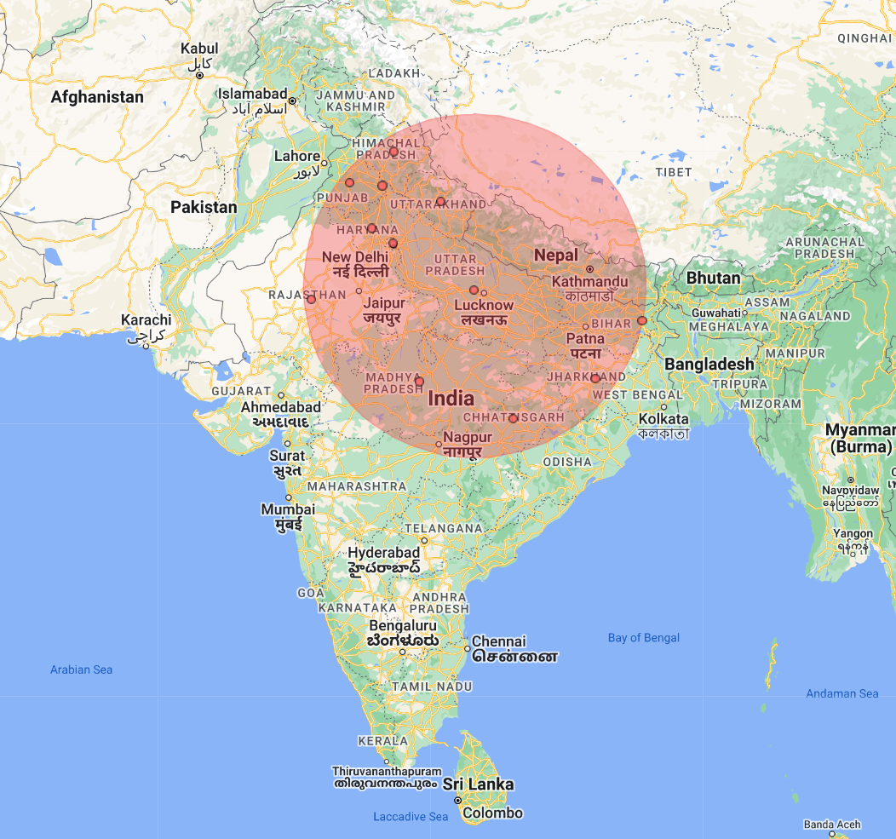

Slide 25
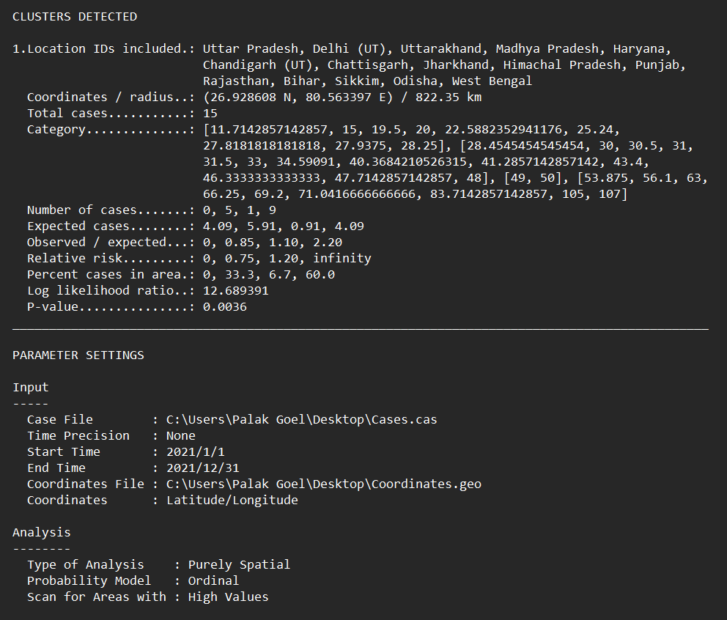
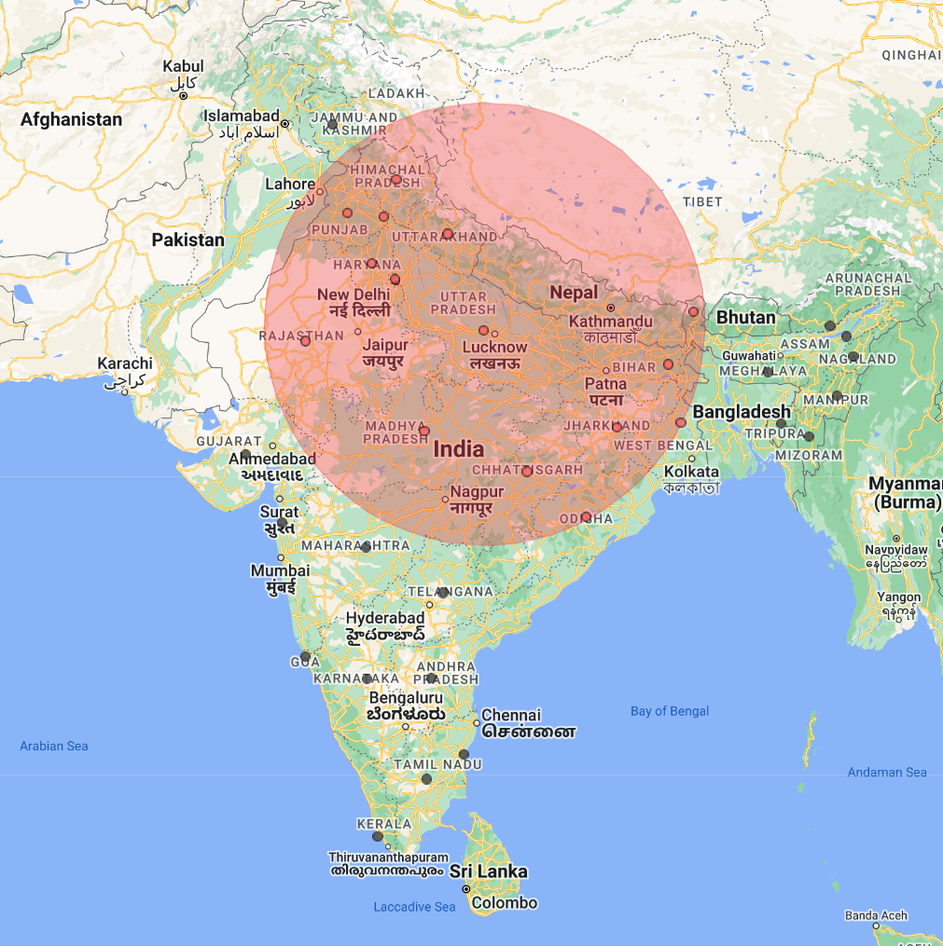
Ordinal model for PM2.5

Slide 26
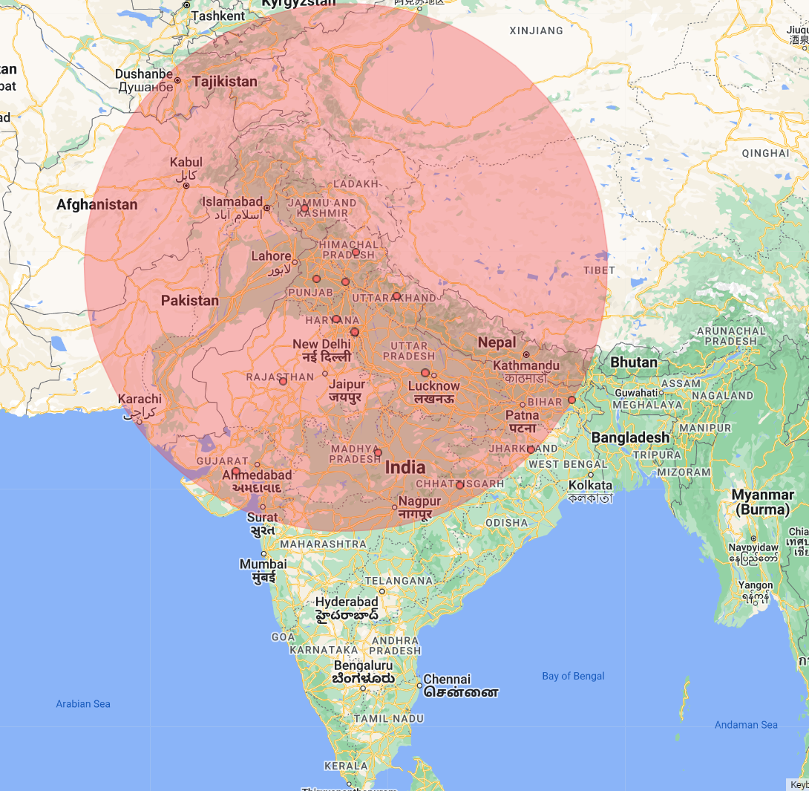
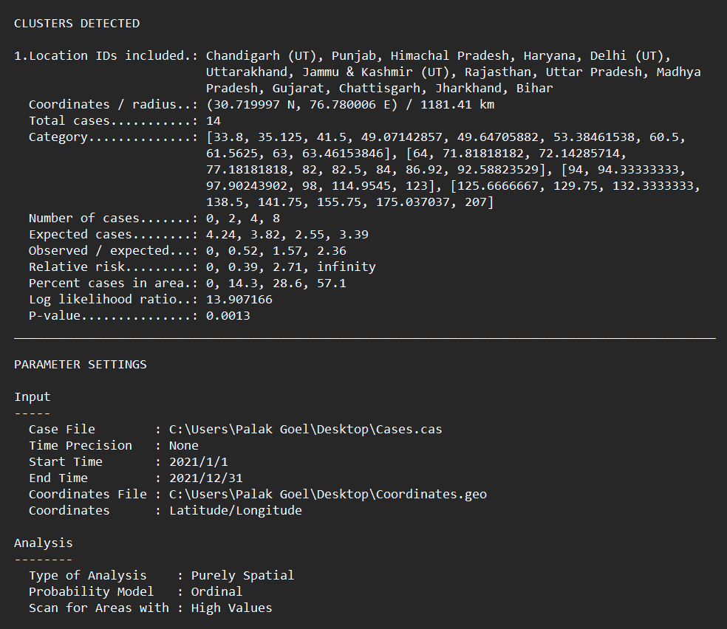
Ordinal model for PM10

Slide 27
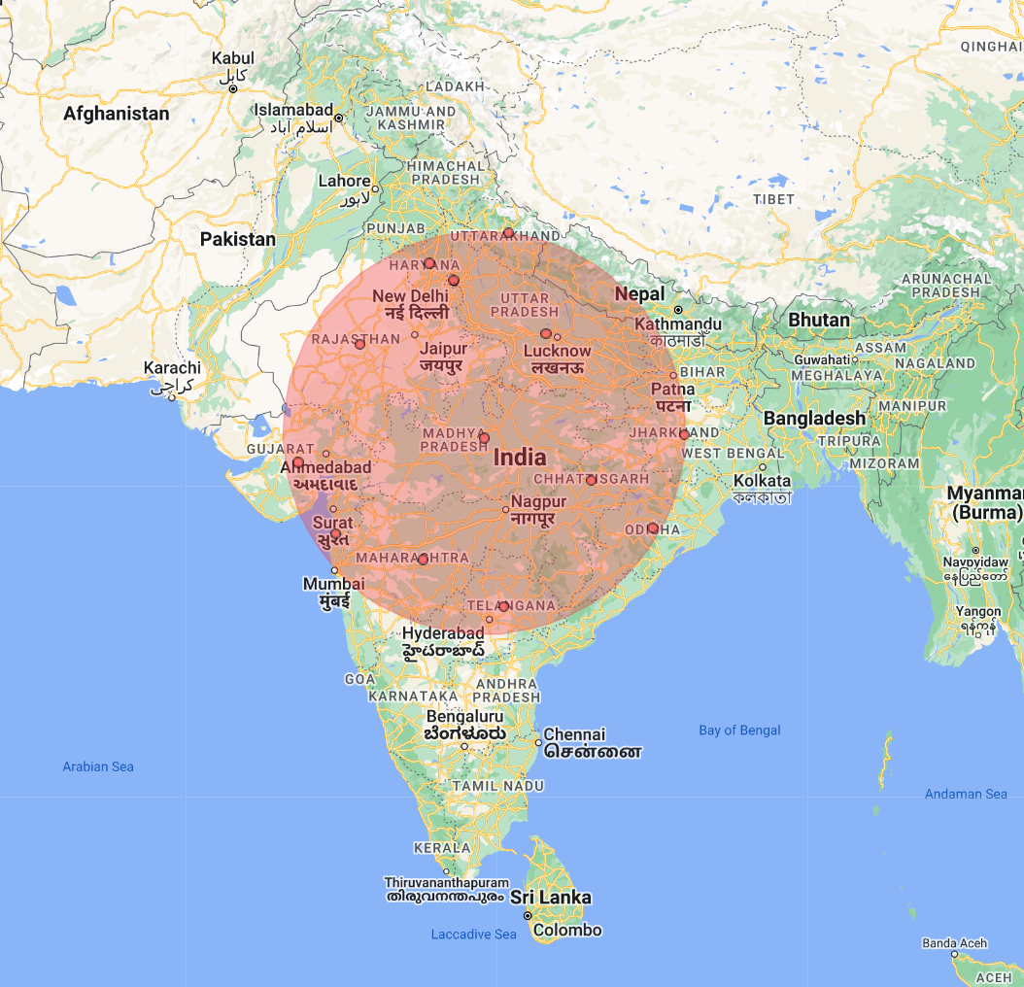
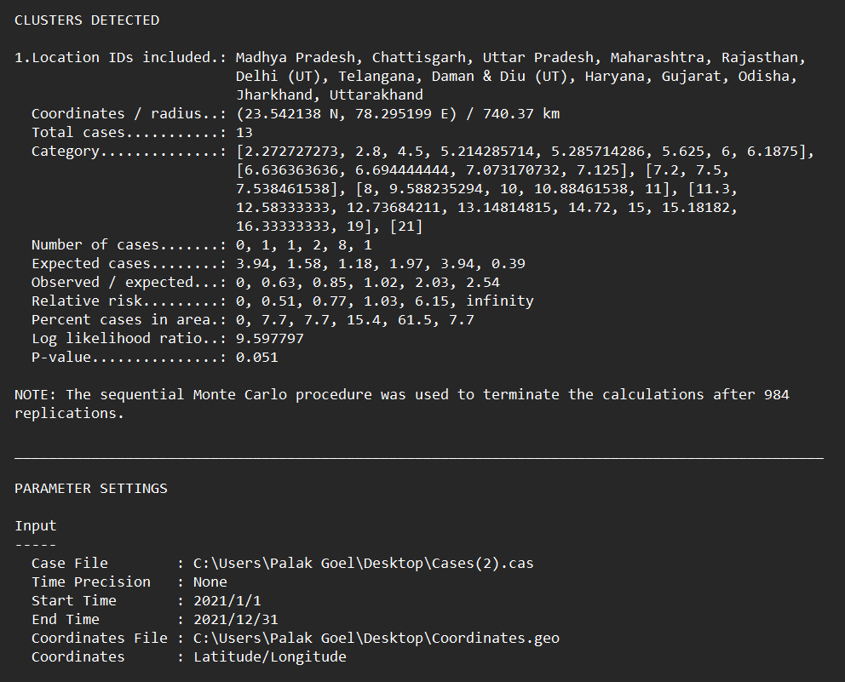
Ordinal Model For SO₂

Slide 28
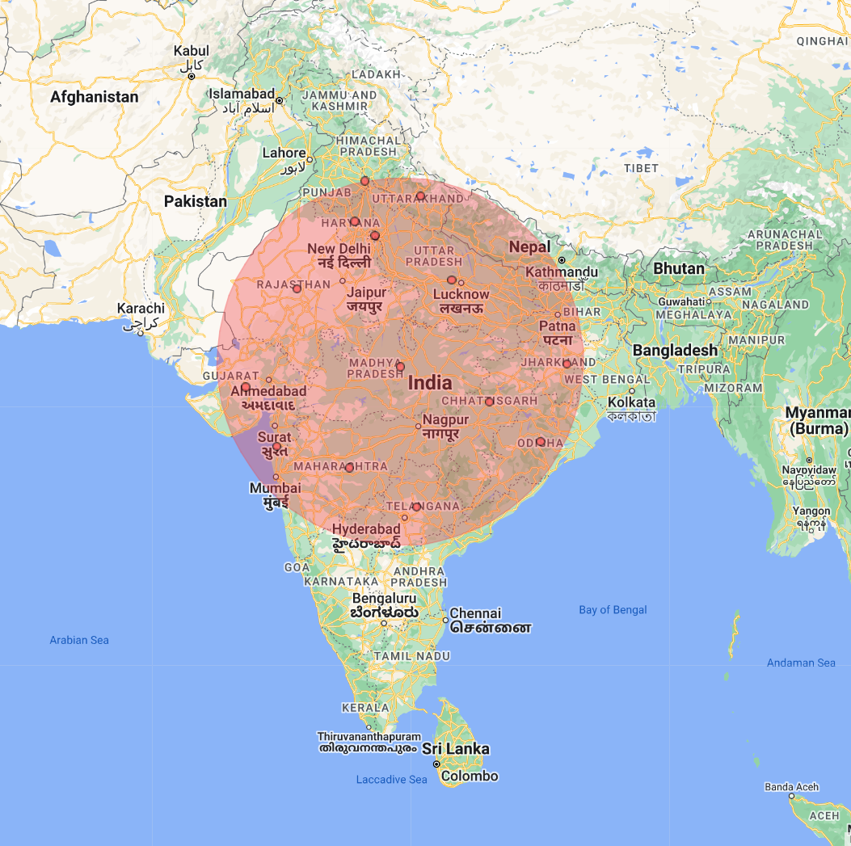
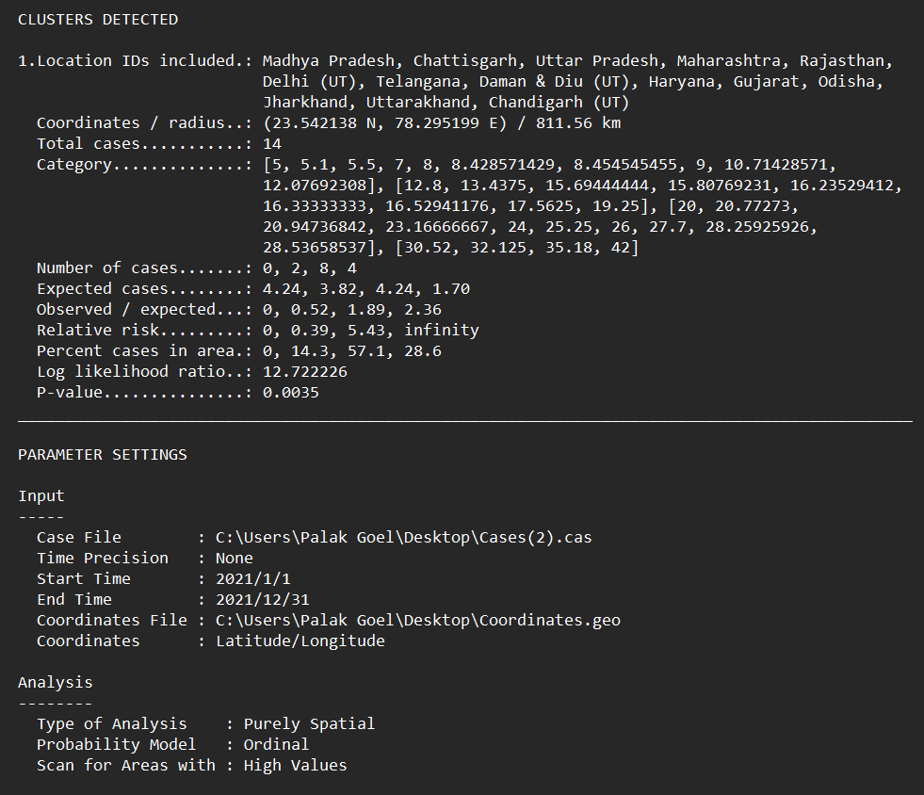
Ordinal Model For NO₂

Slide 29
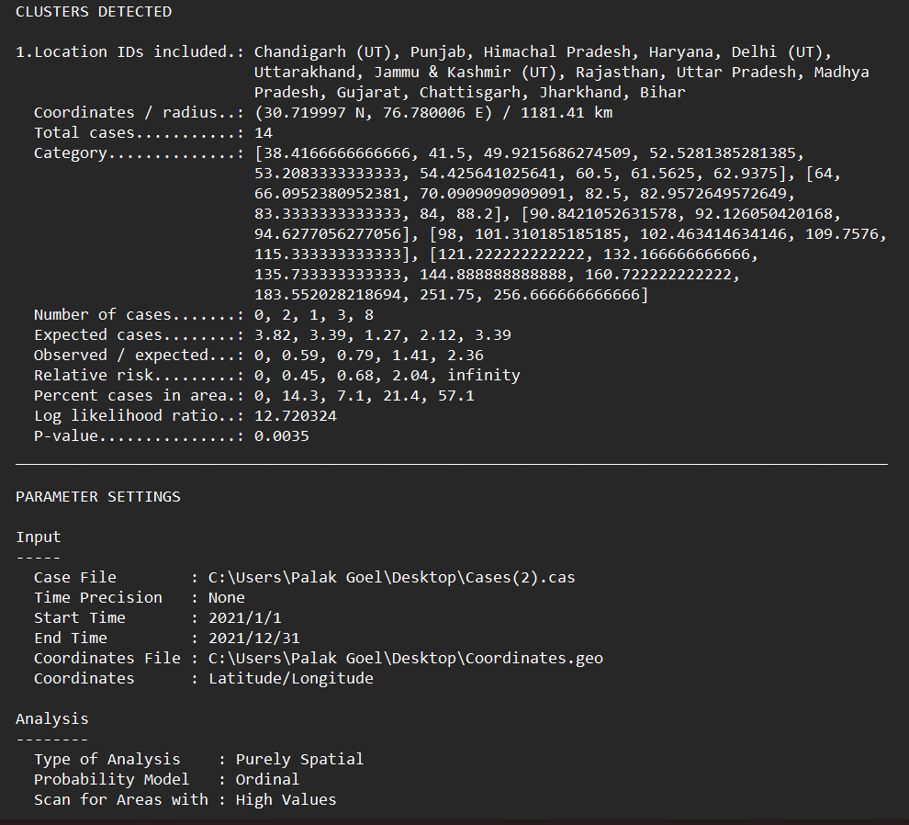
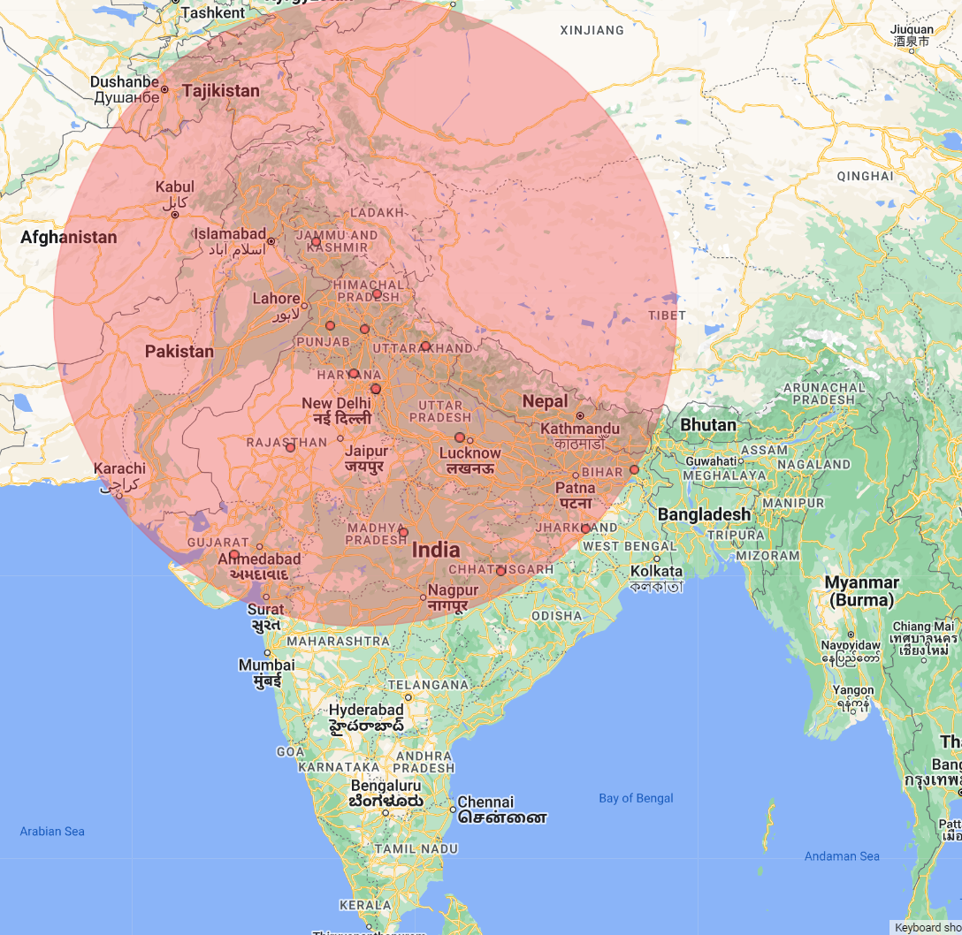
Ordinal model for AQI

Slide 30
Limitations
Air quality prediction models have a number of limitations, including:
Limited data: Air quality prediction models require a data in huge amount to make accurate predictions. However, in many parts of the world, there is limited data available on air quality, which can make it difficult to develop accurate models.
Complex factors: Air quality is affected by a wide range of complex factors, including weather patterns, topography, and human activity. Modeling all of these factors accurately can be challenging.
Uncertainty: There is always some degree of uncertainty associated with air quality prediction models. This can be due to limitations in the data, or the fact that air quality is influenced by many variables that are difficult to predict.
Scale: Air quality models are typically developed at a regional or city-wide scale, which can limit their usefulness for predicting air quality at a more localized level.
Model assumptions: Air quality prediction models are based on certain assumptions about the behavior of pollutants and their interactions with the environment. These assumptions may not always hold true, leading to inaccuracies in the model predictions.
Lack of real-time data: Air quality models rely on data that is often several hours or even days old. This means that they may not accurately reflect the current air quality conditions in a given area.
Difficulty in capturing spatial variability: Air quality prediction models may not be able to accurately capture the spatial variability of air quality within a city or region, leading to inaccuracies in predictions for specific locations

Slide 31
Results
Jharkhand and Tirupura has greater SO2 concentrations than Delhi and Telangana has higher NO2 levels.
Delhi and Jharkhand have greater PM2.5 concentrations.
Higher concentrations of PM10 are found in Delhi and Uttar Pradesh.
Stronger correlation between PM2.5 and PM10, pointing to multicollinearity in our dataset, which will cause dependency among explanatory variables
Moderate 196
Poor 128
Good 50
Unhealthy 23
K nearest neighbour is doing better in prediction as after addressing the issue of over fitting in Decision tree and random forest algorithm
Satscan is utilised to ascertain the statistical significance of clusters reported in space or time. Consequently, my model identifies the concentrations for each type of particulate matter and AQI value.
Comparing the result of the normal model and the ordinal model for PM2.5 in India reveals that the ordinal model provides a more significant result, as well as a log-likelihood value that defines less overlapping in clusters and their significance. Compare numerous circles and choose the one with the highest likelihood value. This region is said to be the most probable cluster. This indicates that such a cluster is caused by human intervention and is unlikely to occur by accident.

Slide 32
Software Requirements
Software
Framework
Anaconda Navigator (v3.9)
Jupyter Notebook (v5.2)
SaTScan (v10.1)
Excel (vDesktop)
NumPy
Pandas
Matplotlib
Seaborn
SkLearn
TensorBoard
21MDT0041 Palak Goel Master Thesis
15

Slide 33
Thank You
By: Guide:
Palak Goel (21MDT0041) Dr. Jitendra Kumar (15975)
MSc. Data Science
School of Advanced Sciences
Vellore Institute of Technology, Vellore
16

